Slide 1
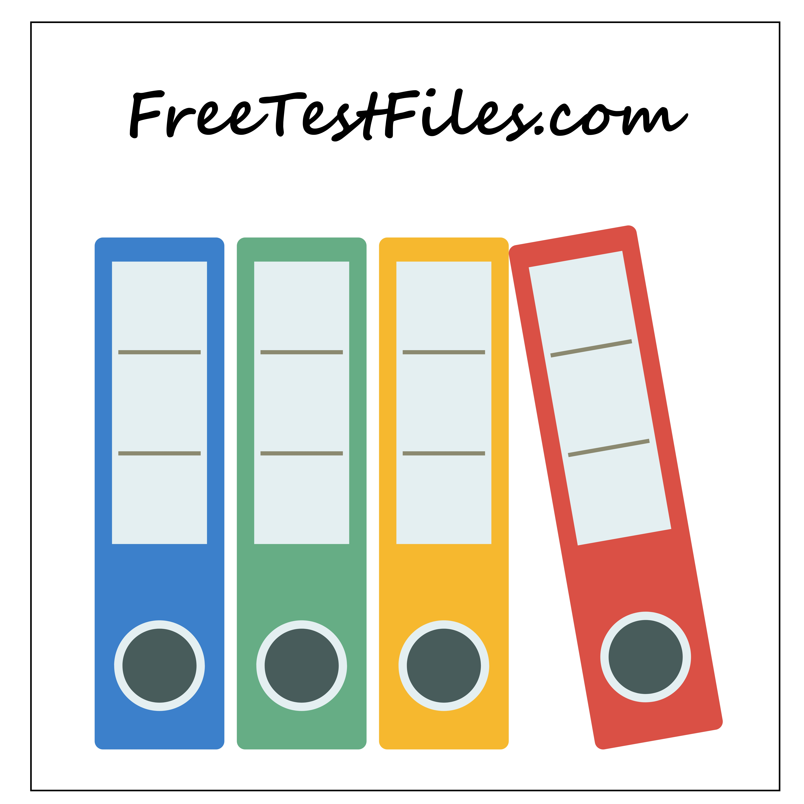
Sample PPT File
This file is for testing purposes only.
Welcome to FreeTestFiles.com, a reliable platform dedicated to providing free test files for testing and educational purposes.

Slide 2
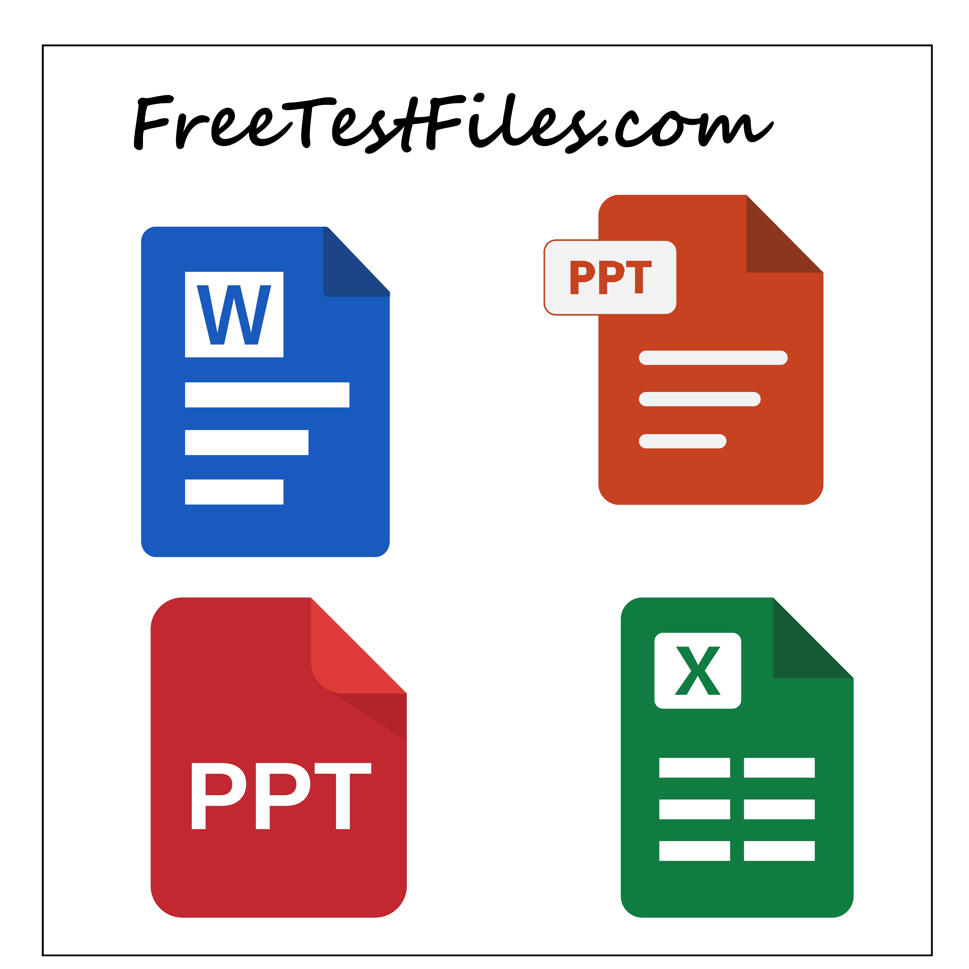
Our Purpose
In today’s digital world, testing is an essential part of everyday work. Whether you are checking internet speed, testing software compatibility, validating upload limits, evaluating device performance, or learning how different file formats behave, you need clean and trustworthy sample files.
FreeTestFiles.com was created to solve this exact problem by offering a centralized collection of commonly used test files in multiple formats and sizes.

Slide 3
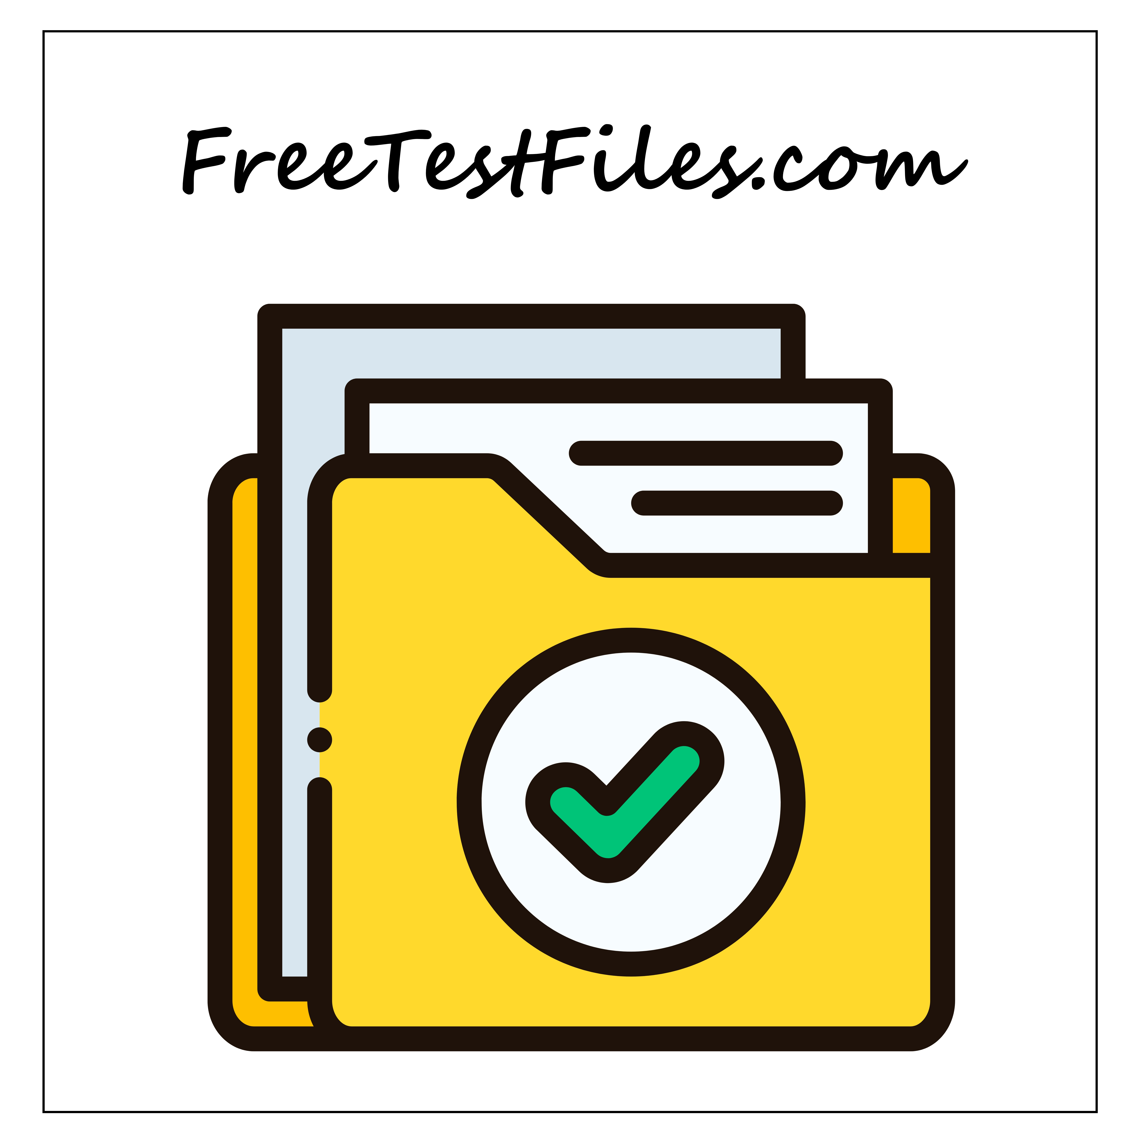
What We Offer
We provide a wide range of sample and test files, carefully structured to meet real-world testing needs. These include:
•Sample PDF files for document and printer testing
•Word, Excel, and PowerPoint files for office and upload testing
•Audio files for media playback and compatibility checks
•Video files for resolution, format, and streaming tests
•ZIP files for compression and extraction testing
•Large files for internet speed, bandwidth, and download stability testing
Each file is created solely for testing and educational purposes and does not contain copyrighted, licensed, or proprietary content.

Slide 4
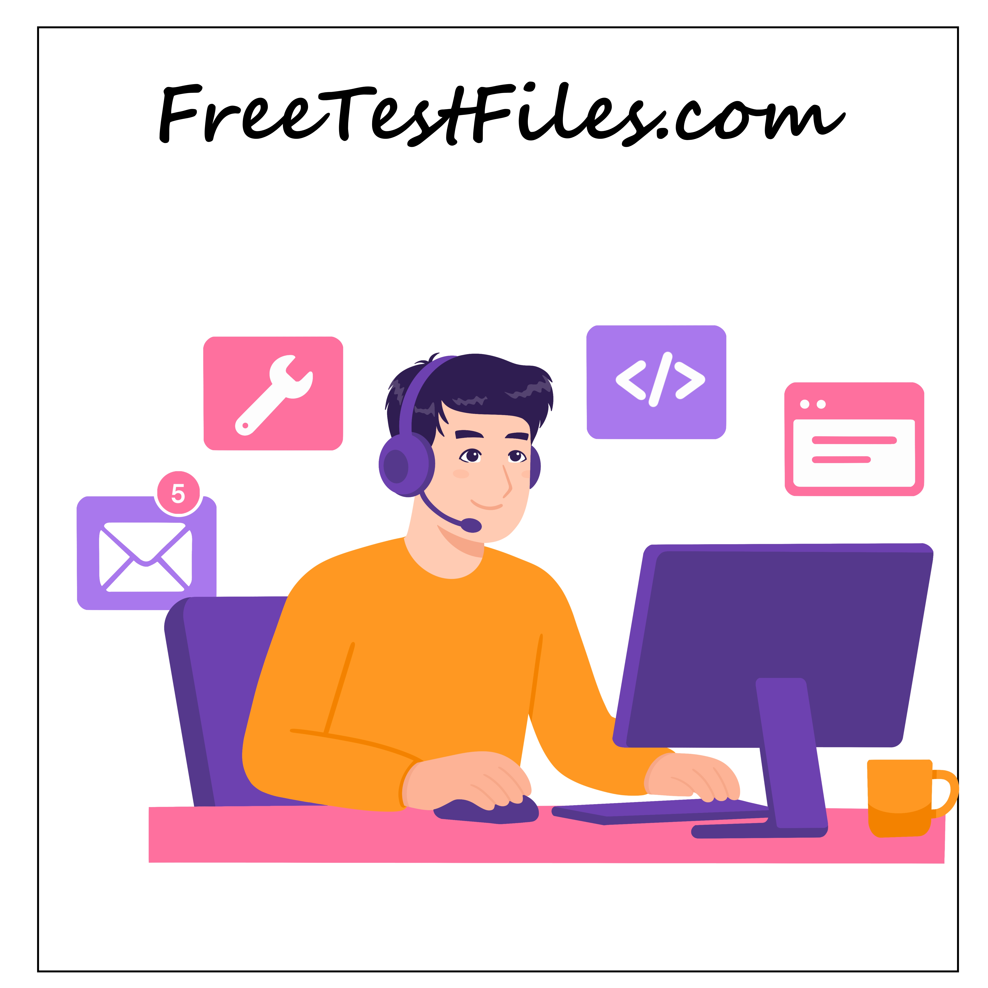
Who Uses Our Website
Our users come from a wide range of backgrounds, including:
Students and learners
Developers and testers
IT professionals and system administrators
Network engineers and internet users
Educators and trainers
Anyone who needs sample files for legitimate testing can benefit from our resources.

Slide 5
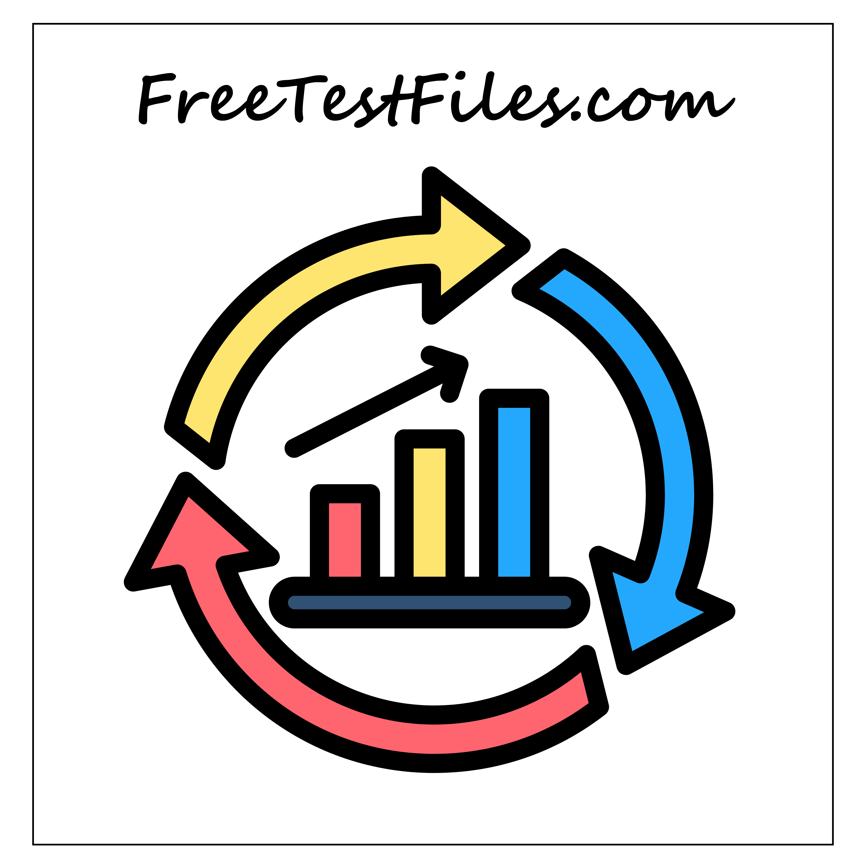
Continuous Improvement
We are continuously working to:
Expand file formats and sizes based on real demand
Improve website performance and usability
Ensure compatibility across devices and browsers
User feedback plays an important role in shaping future improvements.

Slide 6
Get in Touch
If you have questions, suggestions, or feedback, feel free to contact us:
📧 Email: contact@freetestfiles.com
We value user input and strive to make FreeTestFiles.com more useful every day.
Thank You
Thank you for visiting FreeTestFiles.com.
We hope our resources help you test, learn, and work more efficiently.

